Slide 1
Pester
A testing framework for PowerShell
Joey Piccola
Twitter: joeypiccola
Github: https://github.com/joeypiccola

Slide 2
What is testing?
An awful process

Slide 3
What is testing?
Unit Testing
A process for ensuring the scripts you’ve made do what you intend.
Does my function correctly handle errors?
Does my function correctly build a variable?
Does my function correctly evaluate a condition?
Does my script follow the intended logic path?
Acceptance Testing
A process for validating the scripts you've made have done what you intend.
Did my function correctly set a client’s DNS settings?
Was an AD user created correctly?
Was my server provisioned correctly?

Slide 4
Why unit tests?
Assists in the management of your scripts over time
Prevents mistakes when others or yourself make adjustments
Helps define “working”
Enables a level of trust that your script will behave a certain way

Slide 5
Why acceptance tests?
Fast and programmatic way to validate operational tasks or infrastructure
One script to validate a user provisioning process went correctly
One script to verify AD health every morning
Pester’s framework makes it easy

Slide 6
Pester Syntax
Describe, a block to group context and it blocks
Context, a block to group it blocks
It, the specific test we want to run
Mock, a process for replacing a cmdlet (e.g. we don’t really want to run Set-ADUser)

Slide 7
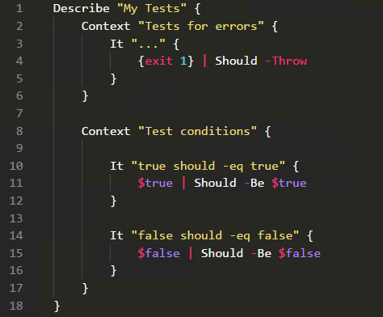
Pester Syntax

Slide 8
Demos

Slide 9
Resources
Adam Bertram
[eBook] The Pester Book
https://leanpub.com/pesterbook)
[CBT] Microsoft Virtual Academy (Testing PowerShell with Pester)
https://goo.gl/vRRpaF
[PodCast] RunAsRadio (Testing PowerShell using PowerShell)
http://runasradio.com/Shows/Show/531
Free e-book giveaway!

